Slide 1
Artificial Intelligence
CS4365 --- Fall 2022
Constraint Satisfication Problem
Instructor: Yunhui Guo

Slide 2
Standard Search Problem
Standard Search Problems:
State is a “black box”: arbitrary data structure
Goal test can be any function over states
Successor function can also be anything

Slide 3
Constraint Satisfication Problems (CSP)
Constraint satisfaction problems (CSPs):
A special subset of search problems
State is defined by variable X_{i} with values from a domain D (sometimes D depends on i)
Goal test is a set of constraints specifying allowable combinations
of values for subsets of variables
Why CSPs?
Allows useful general-purpose algorithms with more power than standard search algorithms

Slide 4

Example: Map-Coloring Problem
Color each region either red, green or blue in such a way that no neighboring regions have the same color
Variables: different regions
Domains: colors

Slide 5
Constraint Satisfication Problems (CSP)
A powerful representation for (discrete) search problems.
A Constraint Satisfication Problem (CSP) is defined by:
X is a set of n variables X₁, X₂, ...., X_{n}, each defined by a finite domain D₁, D₂, ..., D_{n} of possble values
C is a set of constraints C₁, C₂, ..., C_{m}. Each C_{i} involves some subset of the variables; specifices the allowable combinations of values for that subset.
A solution is an assigment of values to the variables that satisfies all constraints.

Slide 6
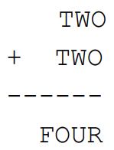
Cyptarithmetic as a CSP
Variables:
F O U R T W C₁ C₂ C₃
Domains:
{0, 1, 2, 3, 4, 5, 6, 7, 8, 9}
Constraints:
O + O = R + 10 * C₁
C₁ + W + W = U + 10 * C₂
C₂ + T + T = O + 10 * C₃
C₃ = F
alldiff(F, O, U, R, T, W)

Slide 7
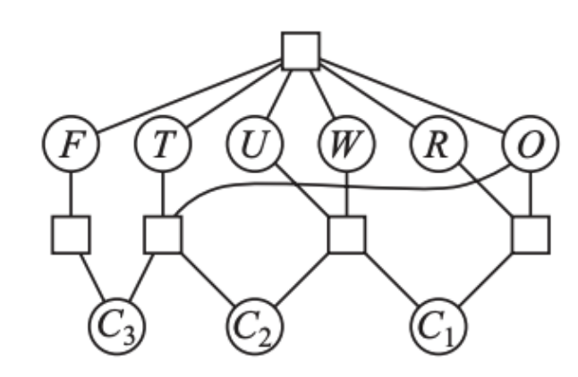
Cyptarithmetic Constraint Graph
Variables:
F O U R T W C₁ C₂ C₃
Domains:
{0, 1, 2, 3, 4, 5, 6, 7, 8, 9}
Constraints:
O + O = R + 10 * C₁
C₁ + W + W = U + 10 * C₂
C₂ + T + T = O + 10 * C₃
C₃ = F
alldiff(F, O, U, R, T, W)

Slide 8
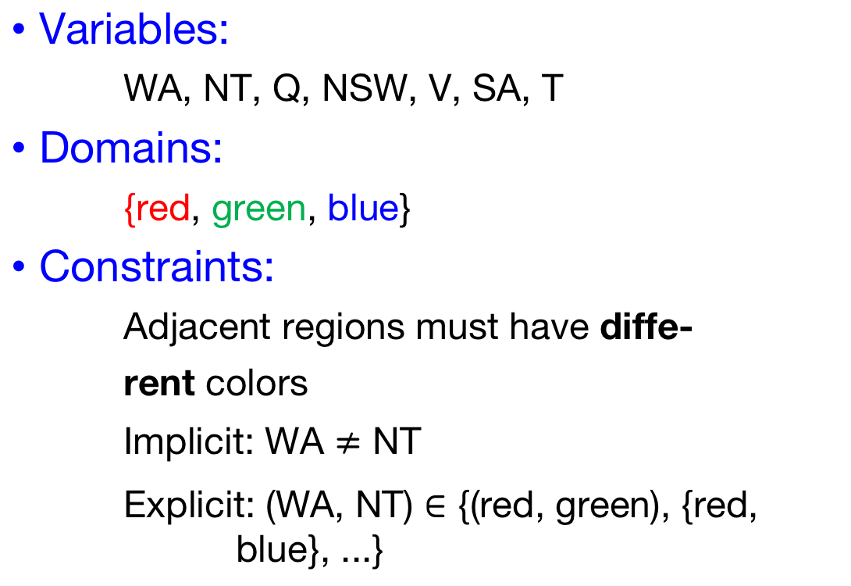
Map-Coloring Problem
Variables:
WA, NT, Q, NSW, V, SA, T
Domains:
{red, green, blue}
Constraints:
Adjacent regions must have diffe-
rent colors
Implicit: WA $≠$ NT
Explicit: (WA, NT) $∈$ {(red, green), {red, blue}, ...}

Slide 9
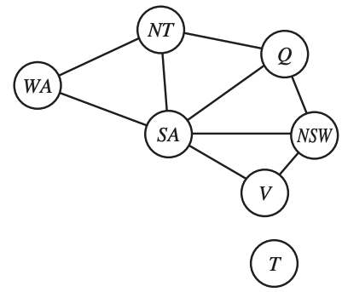
Constraint Graph
Variables:
WA, NT, Q, NSW, V, SA, T
Domains:
{red, green, blue}
Constraints:
Adjacent regions must have diffe-
rent colors
Implicit: WA $≠$ NT
Explicit: (WA, NT) $∈$ {(red, green), {red, blue}, ...}

Slide 10
Map-Coloring Problem
Variables:
WA, NT, Q, NSW, V, SA, T
Domains:
{red, green, blue}
Constraints:
Adjacent regions must have diffe-
rent colors
Implicit: WA $≠$ NT
Explicit: (WA, NT) $∈$ {(red, green), {red, blue}, ...}

Slide 11
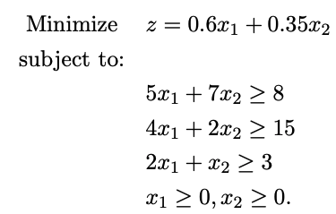
Varieties of CSPs
Discrete variables
Finite domains: each variable can be only assigned to finite number of values.
Infinite domains: each variable can be assigned to infinite number of values, e.g., set of integers
Continuous variables
Linear programming

Slide 12
Varieties of Constraints
Unary constraints involve a single variable (equivalent to reducing domains), e.g.:
SA ≠ Green
Binary constraints involve pairs of variables, e.g.:
SA ≠ WA
Higher-order constraints involve 3 or more variables
Preferences (soft constraints):
E.g., red is better than green

Slide 13
Real-World CSPs
Assignment problems
e.g., who teaches what class
Timetabling problems
e.g., which class is offered when and where?
Transportation scheduling
Factory scheduling

Slide 14
Constraint Satisfication Problems (CSP)
For a given CSP the problem is one of the following:
Find all solutions
Find one solution
The optimal solution given an objective function
Determine if a solution exists

Slide 15
How to View a CSP as a Search Problem?
Initial State -- state in which all the variables are unassigned.
Successor function -- assign a value to a variable from a set of possible values.
Goal test -- check if all the variables are assigned and all the constraints are satsified. We call the assignment is complete.
Path cost -- assumes constant cost for each step

Slide 16
Backtracking Search
Depth-first search for CPSs with single-variable assigments is called backtracking search
- Backtracks when a variable has no legal values left to assign
Backtracking search is the basic uninformed algorithm for CSPs.

Slide 17
The Backtracking Search Algorithm
Backtrack(assignment, csp):
If assignment is complete then return assignment
var ← select one unassigned variable
for each value in the domain of var do
if value is consistent with assignment then
add {var = value} to assignment
result ← Backtrack(assignment, csp)
if result ≠ failure then
return result
remove {var = value} from assignment
return failure

Slide 18
Backtracking Example
NT
Q
WA
SA
NSW
V

Slide 19
The Backtracking Search Algorithm
Backtrack(assignment, csp):
If assignment is complete then return assignment
var ← select one unassigned variable ← which one to select?
for each value in the domain of var do ← which one to use?
if value is consistent with assignment then
add {var = value} to assignment ← detect failure early
result ← Backtrack(assignment, csp)
if result ≠ failure then
return result
remove {var = value} from assignment
return failure

Slide 20
Improving Backtracking Efficiency
General-purpose methods can give huge gains in speed:
1. Which variable should be assigned next?
Choose the most constrained variable, and break ties by choosing the most constraining variable
2. In what order should its values be tried?
Choose the least constraining value
3. Can we detect inevitable failure early?
Forward checking, constraint propagation

Slide 21
Improving Backtracking Efficiency
General-purpose methods can give huge gains in speed:
1. Which variable should be assigned next?
Choose the most constrained variable, and break ties by choosing the most constraining variable
2. In what order should its values be tried?
Choose the least constraining value
3. Can we detect inevitable failure early?
Forward checking, constraint propagation

Slide 22

Variable Selection Heuristic 1: Most Constrained Variable
NT
Q
WA
SA
NSW
V

Slide 23
Variable Selection Heuristic 1: Most Constrained Variable
Most constrained variable:
Choose the variable with the fewest legal values
a.k.a. mininum remaining values (MRV) heuristic
Why min rather than max?
“Fail-fast” ordering
1000× faster or more
NT
Q
WA
SA
NSW
V

Slide 24

Variable Selection Heuristic 2: Most Constraining Variable
Tie-breaker among most constrained variables
NT
Q
WA
SA
NSW
V

Slide 25
Variable Selection Heuristic 2: Most Constraining Variable
Tie-breaker among most constrained variables
Most constraining variable:
choose the variable with the most constraints on remaining variables
NT
Q
WA
SA
NSW
V

Slide 26
Improving Backtracking Efficiency
General-purpose methods can give huge gains in speed:
1. Which variable should be assigned next?
Choose the most constrained variable, and break ties by choosing the most constraining variable
2. In what order should its values be tried?
Choose the least constraining value
3. Can we detect inevitable failure early?
Forward checking, constraint propagation

Slide 27
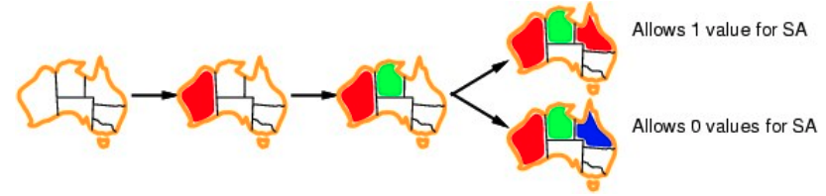
Value Select Heuristic: Least Constraining Value
NT
Q
WA
SA
NSW
V

Slide 28
Value Select Heuristic: Least Constraining Value
Given a variable, choose the least constraining value:
the one that rules out the fewest values in the remaining variables
Why least rather than most?
NT
Q
WA
SA
NSW
V

Slide 29
Variable and Value Ordering Heuristics
The heuristics should be applied whenever a variable/value needs be chosen during the search process
They should not be applied once and for all at the begining of the search process

Slide 30
Improving Backtracking Efficiency
General-purpose methods can give huge gains in speed:
1. Which variable should be assigned next?
Choose the most constrained variable, and break ties by choosing the most constraining variable
2. In what order should its values be tried?
Choose the least constraining value
3. Can we detect inevitable failure early?
Forward checking, constraint propagation

Slide 31
Consistency-Enforcing Procedure 1: Forward Checking
Idea:
Keep track of remaining legal values for unsigned variables
Terminate search when any variable has no legal values
WA
NT
Q
SA
NSW
V
Notes:
Demo:
CS188 javascript demos -> source -> exercises -> csps -> CSPs demos -> CSPs demos.html
Settings:
Graph = Simple
Algorithm = Backtracking
Ordering = None
Filtering = Forward Checking

Slide 32
Consistency-Enforcing Procedure 2: Constraint Propagation
Forward checking propagates information from assigned to unassigned variables, but doesn't provide early detection for all failures:
NT and SA cannot both be blue!
Constraint propagation repeatedly enforces constrains locally.
NT
Q
WA
SA
NSW
V

Slide 33
Consistency-Enforcing Procedure 2: Constraint Propagation
Using the constraints to reduce the number of legal values for a variable
Constraint propagation may be intertwined with search, or it may be done as a preprocessing step, before search starts
Sometimes this preprocessing can solve the whole problem, so no search is required at all!
Local consistency

Slide 34
Arc Consistency
An arc X → Y is consistent iff for every x in the tail there is some y in the head which could be assigned without violating a constraint
Forward checking: Enforcing consistency of arcs pointing to each new assignment
NT
Q
WA
SA
NSW
V

Slide 35
Arc Consistency
An arc X → Y is consistent iff for every x in the tail there is some y in the head which could be assigned without violating a constraint
Important: If X loses a value, neighbors of X need to be rechecked!
Arc consistency detects failure earlier than forward checking
Can be run as a preprocessor or after each assignment
NT
Q
WA
SA
NSW
V

Slide 36
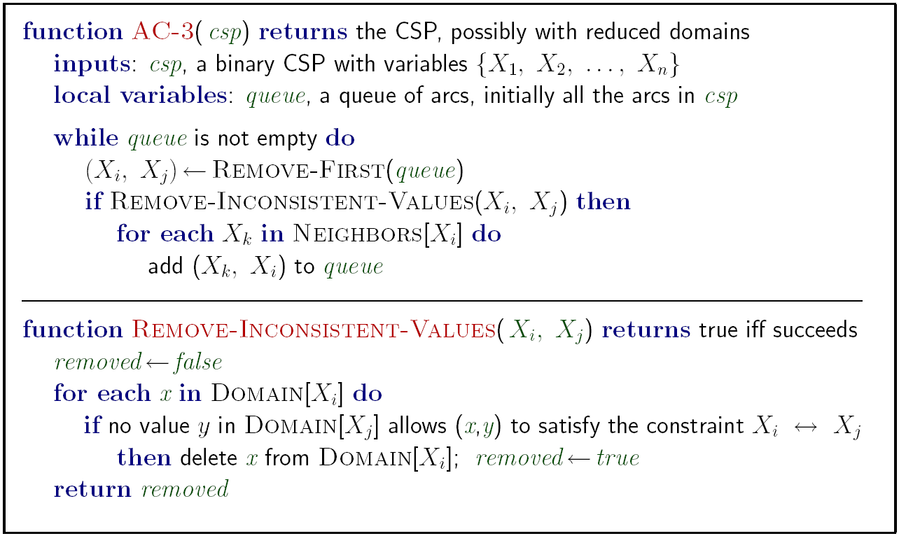
Arc Consistency
Runtime: O(n²d³) n: # of variables d: domain size

Slide 37
Limitations of Arc Consistency
After enforcing arc consistency:
Can have one solution left
Can have multiple solutions left
Can have no solutions left (and not know it)

Slide 38
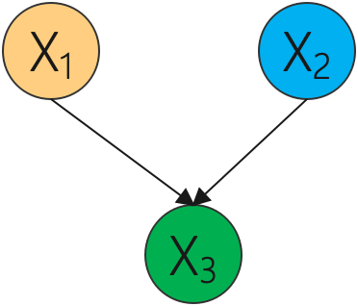
K-Consistency
Increasing degrees of consistency
1-Consistency (Node Consistency): Each single node’s domain has a value which meets that node’s unary constraints
2-Consistency (Arc Consistency): For each pair of nodes, any consistent assignment to one can be extended to the other
K-Consistency: For each k nodes, any consistent assignment to k-1 can be extended to the k^{th} node.

Slide 39
Consistency-Enforcing Procedures
Forward checking
Constraint propagation
Variable/value ordering heuristics
They can used in combination to improve search process.

Slide 40
General Purpose CSP Algorithm
If all values have been successfully assigned then stop, else go on to 2.
Apply the consistency enforcing procedure (e.g. forward checking if feeling computationally mean, or constraint propagation if extravagant.)
If a deadend is detected then backtrack (e.g., DFS-type backtrack.). Else go on to step 4.
Select the next variable to be assigned (using your variable ordering heuristic)
Select a promising value (using your value ordering heuristic)
Create a new search state. Cache the info you need for backtracking. And go back to 1.

Slide 41
Local Search for CSPs
Hill-climbing, simulated annealing typically work with “complete” states, i.e., all variables assigned
To apply to CSPs:
allow states with unsatisfied constraints operators reassign variable values
Variable selection: randomly select any conflicted variable
Value selection by min-conflicts heuristic:
Choose value that violates the fewest constraints
i.e., hill-climb with h(n) = total number of violated constraints

Slide 42
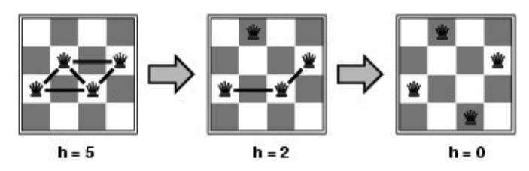
Example: 4-Queens
States: 4 queens in 4 columns (256 states)
Actions: move queen in column
Goal test: no attacks
Evaluation: h(n) = number of attacks
Give random inital state, can solve n-queens in almost constant time for arbirary n with high probability (e.g., n = 10,000,000)

